Slide 1

Module:1 Electronic Materials
Basic Science (Physics) (BSP)
GTU # 3110018
Prof. Vishal S. Vadgama
Humanities and Science Department
vishal.vadgama@darshan.ac.in
+91 8866118980

Slide 2
Topic
Introduction to electronic materials
Electron theory of metals
Classical free electron theory
Quantum free electron theory
Band theory of solids or zone theory
Types of electronic materials: conductor, Insulators, and
semiconductors
Kronig – Penny Model
Energy band structure of a solid
E – K Diagram

Slide 3
Topic
Density of states
Effective mass of an electron
Fermi level and fermi function
Carrier concentration in metals
Phonon

Slide 4

Introduction to
electronic materials

Slide 5

Free electron theory

Slide 6
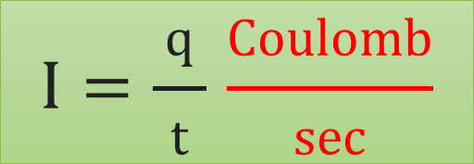
Free electron theory
e⁻
$$I=\frac{ q }{t} \frac{Coulomb}{sec}$$
A
e⁻
e⁻
Current: The flow of electric charge is called electric current.
One ampere current represents one coulomb of electric charge
One coulomb electric charge (q) = 6.24 × 10¹⁸ charge carriers (electrons)

Slide 7
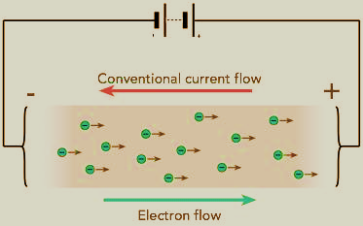

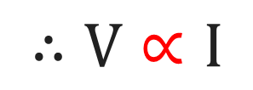
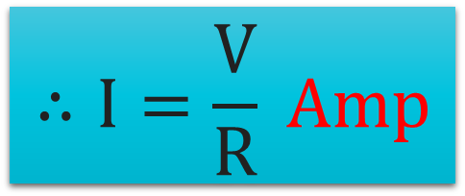

Terms related to electricity
Ohm’s law
$$∴V∝I$$
$$∴V=R I$$
$$∴I=\frac{V}{R} Amp$$

Slide 8
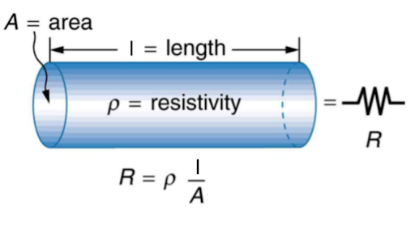
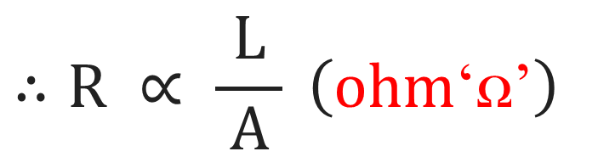
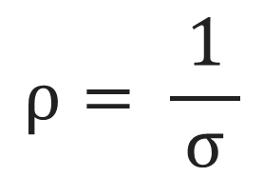
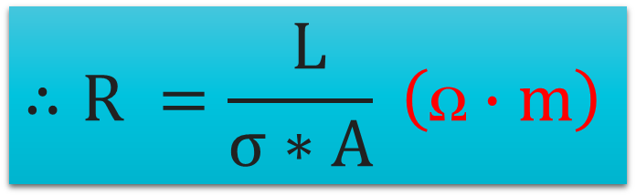
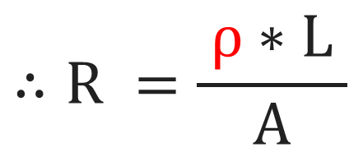
Terms related to electricity
Resistance: It is the opposition that a material offers to the flow of electric current.
$$∴R ∝ \frac{ L }{ A } \left(ohm\text{‘}\text{ꭥ}\text{’}\right)$$
$$∴R =\frac{ ρ∗L }{A}$$
$$∴R =\frac{ L}{σ∗A} \left(\text{ꭥ}∙m\right)$$
$$ρ= \frac{ 1 }{σ}$$
We know,

Slide 9
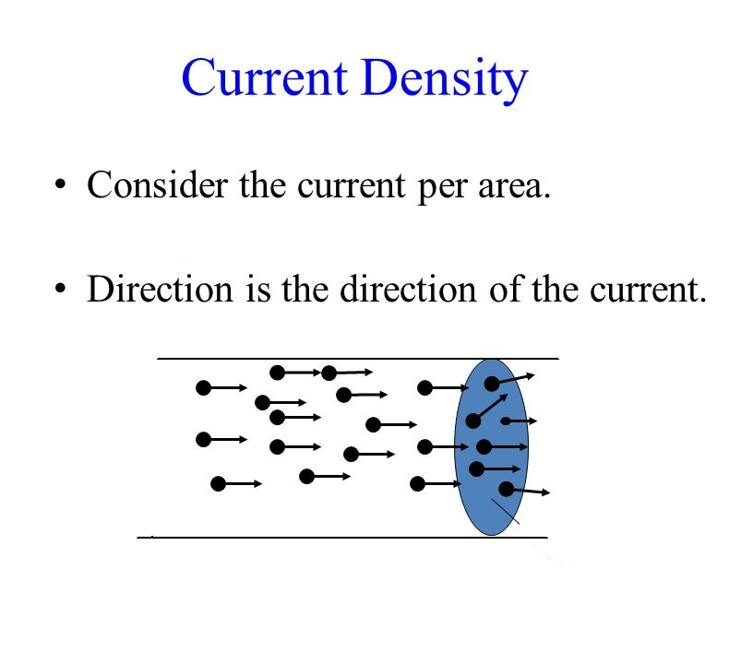
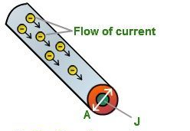
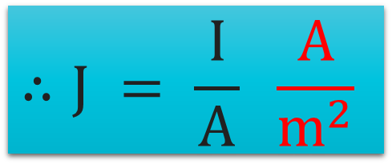
Terms related to electricity
Current density: The amount of electric current flowing per unit cross – sectional
area of a material.
$$∴J = \frac{ I }{A} \frac{ A }{m^{2}}$$

Slide 10
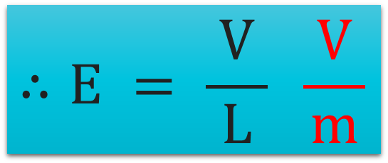

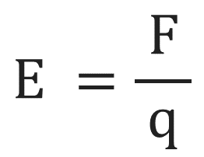
Terms related to electricity
Electric field: Voltage drop per unit length of a conductor.
$$E =\frac{ F }{q}$$
We Know,
V_{f}
$$\overset{→}{E}$$
L
V_{i}
$$∴E = \frac{ V }{L} \frac{ V }{m}$$
This equation is used when a moving charge goes
against the field (E).

Slide 11
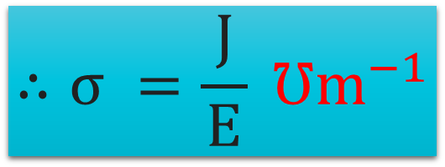
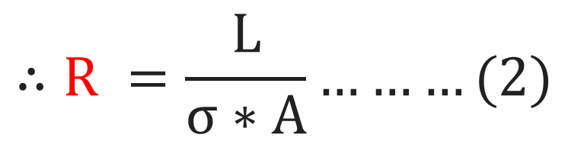
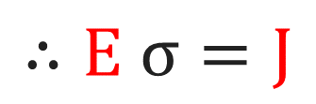
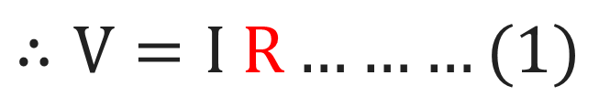
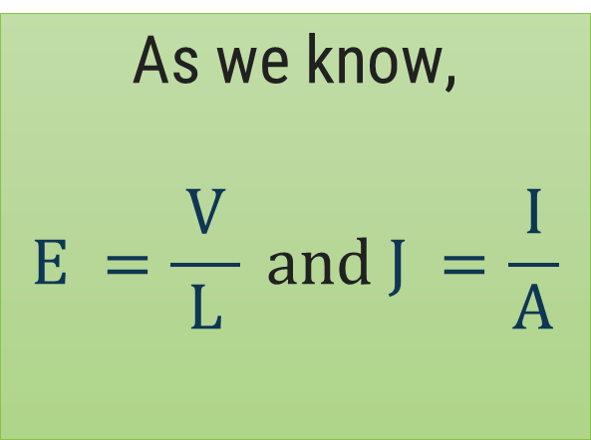
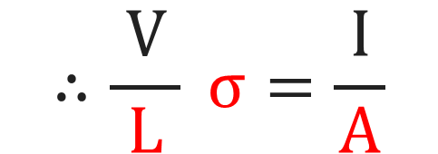
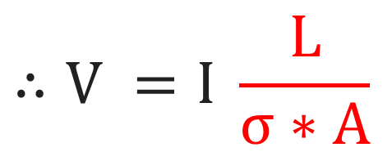
Terms related to electricity
Electric conductivity: The amount of electric current, a material can carry.
$$∴R =\frac{ L }{σ∗A}………(2)$$
$$∴V=I R………(1)$$
Ohm’s law
$$∴V =I \frac{ L }{σ∗A}$$
$$∴\frac{ V }{L} σ=\frac{ I }{A}$$
As we know,
$$E =\frac{ V }{L} and J =\frac{ I }{A}$$
$$∴E σ=J$$
$$∴σ =\frac{ J }{E} ℧m^{−1}$$
Rate of charge flow across unit area (J)
Per unit potential field (E)

Slide 12
Classification of
free electron theory
Classical free electron theory
Quantum free electron theory
Band theory
By
Drude-Lorentz Theory
By
Sommerfeld Theory
By
Bloch
Theory

Slide 13
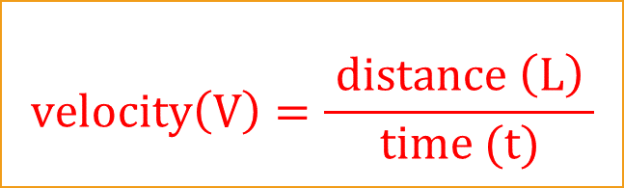
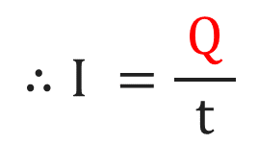
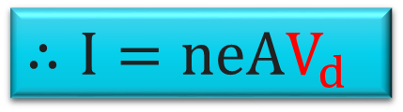
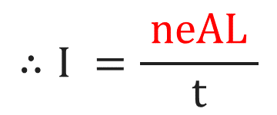

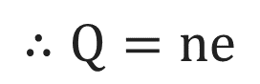
Basic terms involved in free electron theory
Drift velocity (V_{d}): The average velocity of charge carriers due to electric field.
Total Charge (Q) for an area (A) and length (L)
L
$$∴Q=ne$$
$$∴Q=neAL$$
e⁻
e⁻
A
e⁻
$$∴I =\frac{ Q }{t}$$
$$∴I =\frac{ neAL }{t}$$
$$∴I=neAV_{d}$$
$$velocity\left(V\right)=\frac{ distance \left(L\right) }{time (t)}$$

Slide 14
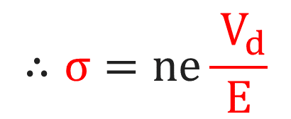
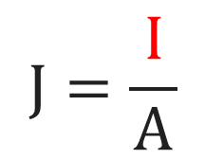
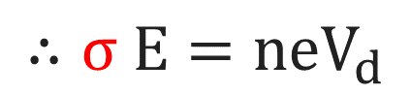
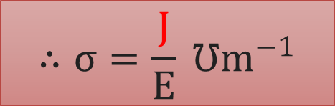
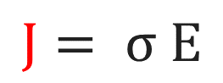
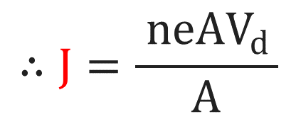
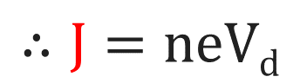
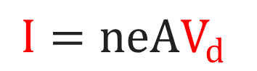

Basic terms involved in free electron theory
Role of mobility in electrical conductivity:
Mobility (𝛍): It is the drift velocity (V_{d}) acquired by electron (e⁻) per unit electric field.
$$J=\frac{ I }{A}$$
Current density:
Drift velocity:
$$I=neAV_{d}$$
/
$$∴J=\frac{ neAV_{d }}{A}$$
$$∴σ E=neV_{d}$$
/
$$∴σ=ne\frac{ V_{d}}{E}$$
From, electrical conductivity
$$∴J=neVd$$
$$∴σ=\frac{J}{E} ℧m^{−1}$$
$$J= σ E$$
$$∴σ=neμ$$
But,

Slide 15
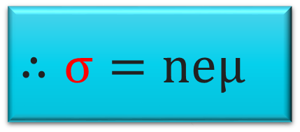
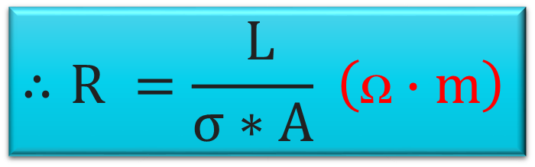
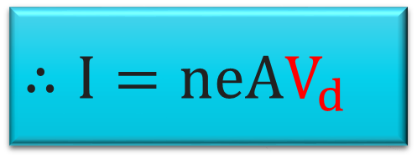
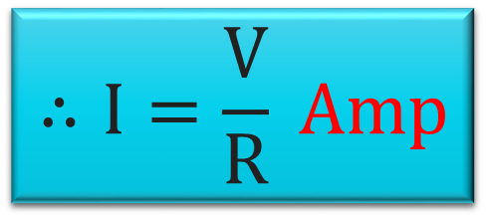
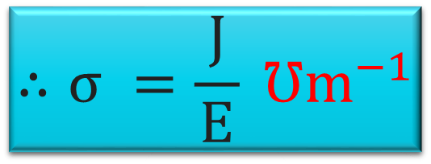
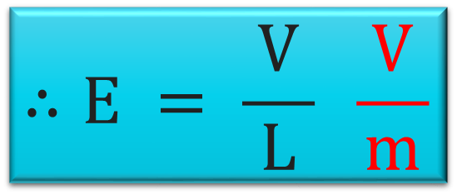
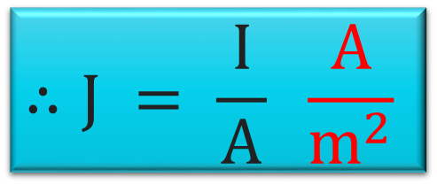
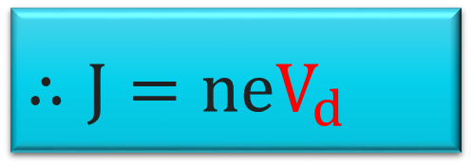
All equations
$$∴I=\frac{V}{R} Amp$$
$$∴σ =\frac{ J }{E} ℧m^{−1}$$
$$∴R =\frac{ L}{σ∗A} \left(\text{ꭥ}∙m\right)$$
$$∴I=neAV_{d}$$
$$∴J = \frac{ I }{A} \frac{ A }{m^{2}}$$
$$∴J=neV_{d}$$
$$∴E = \frac{ V }{L} \frac{ V }{m}$$
$$∴σ=neμ$$

Slide 16
Classical free electron theory
In 1900, Drude proposed free electron theory for metals using some basic
assumptions.
The valence electrons are free to move inside the metal just like gas molecules
inside a container.
e⁻
e⁻
e⁻
e⁻
This well arranged atoms or molecules
in any system are called lattice
e⁻
e⁻
e⁻
e⁻

Slide 17
Assumptions/postulates of classical free electron theory
Metal structure consists positive ion core, with valence electrons moves
freely among these ion cores.
These valence electrons moves inside metal just like molecules in gas.
In the absence of electric field (E = 0), free electrons moves in random
directions and collide with each other.
e⁻
In the collisions, no loss of energy will observed because collisions are elastic.
When electric filed is applied (E ≠ 0), the free electrons are accelerated in direction opposite to
field.
Free electrons obey Maxwell-Boltzmann statistics.
E ≠ 0

Slide 18
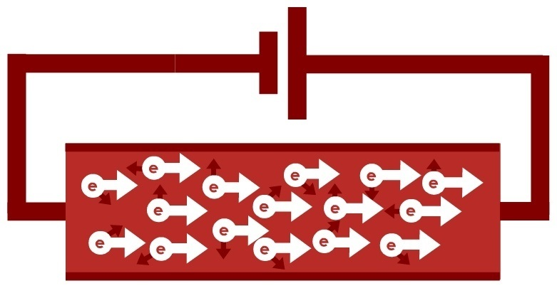
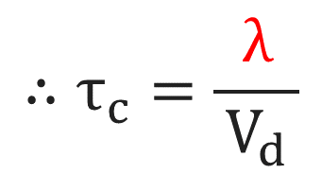
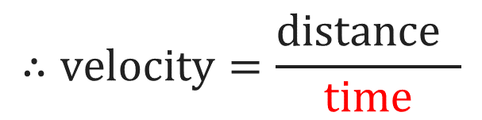
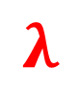
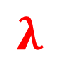
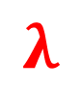
Basic terms involved in free electron theory
Relaxation time (τ): Time taken by an electron to reach equilibrium position from disturbed
position, in presence of electric field.
Mean free path (λ): The average distance travelled by electron between two successive collisions.
Mean collision time (τ_{c}): The average time between two successive collisions of electron.
e⁻
e⁻
e⁻
e⁻
$$λ$$
$$λ$$
$$λ$$
$$∴velocity=\frac{distance }{time}$$
$$∴τ_{c}=\frac{ λ }{V_{d}}$$

Slide 19
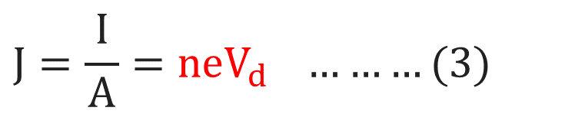








Expression for electrical conductivity
When electric field is applied, electrons experience a force
$$∴F=eE$$
As, electrons collision occurs during motion, the electrons will
get accelerated momentarily so, the drift velocity will be
But,
$$F=ma$$
$$∴V_{d}=a τ$$
$$Acceleration(a)=\frac{ velocity(v) }{time(t)}$$
$$∴V_{d}=\frac{ eE }{m}τ ………(2)$$
$$∴ma=eE$$
$$∴a=\frac{ eE }{m} ………(1)$$
$$J=\frac{ I }{A}=neV_{d} ………(3)$$
Current density
$$∴J=ne\frac{ eE }{m}τ=\frac{ ne2Eτ }{m} ………(4)$$

Slide 20




Expression for electrical conductivity
$$From previous slide$$
$$J=ne\frac{ eE }{m}τ=\frac{ ne2Eτ }{m} ………(4)$$
From, electrical conductivity
$$J=σE ………(5)$$
/
$$∴σE=\frac{ ne2Eτ }{m}$$
/
$$∴σ=\frac{ ne2τ }{m}………(6)$$
Expression for electrical conductivity

Slide 21








Conductivity in terms of K_{B}T (Ave. kinetic energy)
The relaxation time ($τ$) in terms of mean free path (λ) and average thermal velocity is given by:
$$∴τ=\frac{λ}{V} ………(7)$$
$$∴m= \frac{ 3KBT }{V2} ………(8)$$
Kinetic energy of an electron based on kinetic theory
Using equation (8) & (7) in (6)
$$∴σ =\frac{ ne2\left(\frac{λ}{V}\right) }{\frac{ 3K_{B}T }{V2}}$$
/
$$∴\frac{ 1 }{2}mV2= \frac{ 3 }{2}KBT$$
$$=\frac{ ne2λV2 }{3K_{B}TV}$$
From equ. (9)
$$↓σ∝ \frac{1}{T↑}$$
/
/
/
$$As we know,$$
$$σ=\frac{ ne2τ }{m}………(6)$$
Here, K_{B}T = Boltzmann constant
$$∴σ=\frac{ ne2λV }{3K_{B}T} ………(9)$$

Slide 22





Numerical
Q. A current of 5 A is passing through a metallic wire of cross sectional area 4×10⁻⁶
m². If the density of the charge carriers in the wire is 5×10²⁶ /m³, find the drift
speed of the electrons. (e = 1.6×10⁻¹⁹)
I = 5 A
A = 4×10⁻⁶ m²
n = 5×10²⁶ /m³
V_{d} = ?
$$∴I=neAV_{d}$$
The relation between current (I) and drift velocity (V_{d}) of electron in wire of area (A) is
$$∴I=neAV_{d}$$
Where, n is the density of (free) electrons in the wire
$$∴Vd=\frac{ I }{neA}$$
$$∴Vd=\frac{5}{\left(\text{5}\text{×}{10}^{26}\right)\left(\text{1.6}\text{×}{10}^{−19}\right)\left(\text{4}\text{×}{10}^{−6}\right)}$$
$$∴Vd=\text{1.}\text{5}\text{×}{10}^{−2} \text{m}\text{/}\text{s}$$

Slide 23








Numerical
Q. A conductor has an electron concentration of 5.9×10²⁸ /m³. What density in the
conductor corresponds to a drift velocity of 0.625 m/sec. Calculate the mobility
of charge carriers. Given σ = 6.22×10⁷ Ʊm⁻¹.
n = 5.9×10²⁸ /m³
V_{d} = 0.625 m/sec
e = 1.6×10⁻¹⁹
J = ?
μ = ?
$$∴J=neVd$$
$$=(\text{5.9}\text{×}\text{1028})$$
(1.6×10⁻¹⁹)
(0.625)
J = 5.9×10⁹ A/m²
$$∴σ=neμ$$
$$∴σ=neμ$$
$$=\frac{\left(\text{6.22}\text{×}{10}^{7}\right)}{\left(\text{5.9}\text{×}{10}^{28}\right)\left(\text{1.6}\text{×}{10}^{−19}\right)}$$
$$∴J=neVd$$
$$∴μ=\frac{ σ }{ne}$$
$∴$μ = 6.588×10⁻³ m²/V·sec

Slide 24








Numerical
Q. Calculate drift velocity of free electrons with a mobility of 3.5×10⁻³ m² /V·sec in
copper for an electric field strength of 0.5 V/m.
μ = 3.5×10⁻³ m²/V·sec
E = 0.5 V/m
V_{d} = ?
$$∴μ=\frac{ Vd }{E}$$
$$∴J=neVd$$
$$J= σE$$
$$∴σE=neV_{d}$$
$$∴Vd=μE$$
$$∴Vd=\left(\text{3.5}\text{×}{\text{10}}^{−3}\right) \left(0.5\right)$$
$$∴\frac{ Vd }{E}=μ$$
$$∴Vd=\text{1.75}\text{×}{\text{10}}^{−3} m/sec$$

Slide 25


Expression for thermal conductivity (K)
It is defined as the rate of heat flow across a unit area of conductor per unit
temperature gradient.
B
Lower Temp.
(T-dT)
$$∴K=\frac{∆Q}{ A \left(\frac{dT}{dx}\right) } \frac{Watt}{ meter∙Kelvin }$$
λ
ΔQ = rate of heat flow (thermal energy)
A = Cross-sectional area of conductor
$$\left(\frac{dT}{dx}\right)=temperature gradient$$
e⁻
e⁻
e⁻
Higher
Temp. (T)
A
n = density of electrons
v = velocity of electrons

Slide 26









Expression for thermal conductivity (K)
Average kinetic energy at A = $\frac{ 3 }{2}KB (T)$
Average kinetic energy at B = $\frac{ 3 }{2}KB (T−dt)$
The excess energy carried by electrons
in traveling from point A to B
So, excess energy transferred from A to B
per unit area in unit time is:
$$\frac{ 3 }{2}KBT=\frac{ 3 }{2}KB (T−dT)$$
$$\frac{ 1 }{6}nv×\frac{ 3 }{2}KBdT$$
$$=\frac{ 1 }{4}nvKBdT$$
$$\frac{ 3 }{2}KBT=\frac{ 3 }{2}KB dT$$
Similarly, deficiency of energy from B to A
per unit time is:
$$\frac{ n }{6}$$
The electrons travel in all directions
crossing unit area from A to B
$$−\frac{ 1 }{4}nvKBdT$$
$$i.e. \frac{ 1 }{6}nv$$

Slide 27






Expression for thermal conductivity (K)
The rate of heat flow can be defined as the
net energy transferred from A to B per unit
area per unit time:
We know thermal conductivity k is defined as:
$$∴K=\frac{ ∆Q}{ \left(\frac{ dT }{dx}\right) }$$
Here, dx can be written as
mean free path (λ)
$$∴∆Q=\frac{ 1 }{4}nvKBdT−\left(−\frac{ 1 }{4}nvKBdT\right)$$
$$∴K=\frac{ \frac{ 1 }{2}nvKBdT }{ \left(\frac{ dT }{λ}\right) }$$
/
/
λ
$$∴∆Q=nvKBdT \left(\frac{ 1 }{4}+\frac{ 1 }{4}\right)$$
$$∴∆Q=\frac{ 1 }{2}nvKBdT$$
$$∴K=\frac{1}{2}nvKBλ$$

Slide 28







Wiedemann-Franz law
This law states that the ratio of thermal conductivity to electrical conductivity is directly
prepositional to the absolute temperature.
$$i.e. \frac{ K }{σ}∝T$$
By, taking ratio
Theoretical value of L: 1.12 × 10⁻⁸ WΩ/K²
$$∴\frac{ K }{σ}=\frac{ \frac{ 1 }{2}nVKBλ }{\frac{ ne2λV }{3KBT}}$$
/
/
/
Experimental value of L: 2.44 × 10⁻⁸ WΩ/K²
$$∴\frac{ K }{σ}=L T$$
/
/
/
Theoretical and experimental values of L
doesn’t match with each other.
L = Lorentz number
$$∴\frac{ K }{σ}=\frac{3}{2}{\left(\frac{ KB }{e}\right)}^{2}T$$
$$∴K=\frac{ 1 }{2}nVKBλ$$
So, Assumption is wrong that all electrons
contributes in thermal conductivity.
$$∴σ=\frac{ ne2λV }{3K_{B}T}$$
$$∴\frac{K}{σ}=L T$$

Slide 29
Success of free electron theory
It verifies ohm’s law.
It explains the thermal and electrical conductivities of a metal.
It helps to deduce Wiedemann – Franz law.
It explains optical properties of metals.

Slide 30

Drawbacks of classical free electron theory
Theoratical value of specific heat and electronic specific heat of metal based is $\left(\frac{ 3R }{2}\right)$ is not in
agreement with the experimental value (10⁻⁴ RT).
The classical free electron theory can’t explain electrical conductivity of insulators and
semiconductors.
According to classical theory, $\frac{ K }{σ }=T$ is constant at all temperature. But, this is not constant at
low temperature.
It failed to explain the superconductivity and magnetic susceptibility (χ).
The phenomena such as photoelectric effect, Compton effect and black body radiation can’t be
explained.
According to classical free electron theory, the electrical conductivity (σ) proportional to the
free electron density (n). But it failed to explain for different metals.

Slide 31
Quantum free electron theory
After the failure of classical free electron theory for electrical, optical and thermal
properties of metal, modification became necessary.
The quantum statistical approach was introduced by Sommerfeld in 1928.
Here, the observed and predicted values of specific heat and paramagnetic
susceptibility of metal was corrected by quantum theory.
The classical approach was made by Maxwell-Boltzmann statistics while,
sommerfeld used Fermi-Dirac statistics for quantum approach.

Slide 32
Quantum free electron theory
Y
ψ = Probability of electrons
(Wave Function)
K.E. = (↑)
P.E. = 0
e⁻
e⁻
e⁻
e⁻
e⁻
ψ = (↑)
X
Z

Slide 33
Quantum free electron theory
Y
ψ = Probability of electrons
(Wave Function)
At the boundary
K.E. = 0
e⁻
e⁻
P.E. = (↑)
e⁻
ψ = 0
X
L
Z
Boundary condition
X = 0
X = L
ψ = 0
ψ = 0

Slide 34
Quantum free electron theory
Each metal contains a very large number of electrons and these electrons can
move freely inside the metal.
Inside of the metal material uniform potential is applied:
constantly moving electrons has only kinetic energy (K.E.) inside the metal
while the potential energy (P.E.) is zero.
P.E. = 0 can be only possible when,
Interaction of free electron with other electron and metallic core of the metal
is negligible.

Slide 35



Particle in one dimensional box
K.E. inside the material is not sufficient to overcome
metal boundary.
In quantum approach electrons moves in wave form and
wave nature of particle is given by Schrodinger.
Y
Schrodinger wave equation for 3-dimension:
K.E. ≠ 0 (↑)
P.E. = 0
$$∴\frac{ d^{2}ψ }{dx^{2}}+\frac{ d^{2}ψ }{dy^{2}}+\frac{ d^{2}ψ }{dz^{2}}+\frac{ 2m }{{\text{ℏ}}^{2} }[E−V]ψ=0$$
ψ ≠ 0
e⁻
Schrodinger wave equation for 1-dimension:
L
X
$$∴\frac{ d^{2}ψ }{dx^{2}}+\frac{ 2m }{{\text{ℏ}}^{2} }\left[E−V\right]ψ=0………(1)$$
Z
X = 0
X = L
ψ = 0
ψ = 0
E = total energy, V = potential energy, m = mass of electron
$\text{ℏ}$ = modified planck’s constant $\left(\text{ℏ=}\frac{ h }{2π}\right)$

Slide 36





Particle in one dimensional box
In our case P.E. = 0
So, total energy (E) of the system
is because of only K.E.
$$\frac{d^{2}ψ}{dx^{2}}+\frac{2m}{{\text{ℏ}}^{2} }\left[E−V\right]ψ=0………(1)$$
To identify complementary function of $ψ$:
E = total energy,
V = potential energy,
m = mass of electron
$$∴ψ=\left[A coskx+B sinkx\right]………(3) (remember)$$
$$∴\frac{ d^{2}ψ }{dx^{2}}+\left(\frac{ 2m }{{\text{ℏ}}^{2} }E\right)ψ=0$$
Where, k = wave vector, A & B are constants
In order to find the values of A & B we can use two
boundary condition at X = 0 and X = L.
$$Consider,\left(\frac{ 2m }{{\text{ℏ}}^{2} }E\right)=k2$$
Y
At X = 0 → ψ = 0
X = L → ψ = 0
ψ ≠ 0
e⁻
$$∴\frac{ d^{2}ψ }{dx^{2}}+k2ψ=0………(2)$$
X
Z
Implying these two boundary condition values in
equation (3) for ψ
X = 0
L
X = L
ψ = 0
ψ = 0

Slide 37






Particle in one dimensional box
For, (1) X = 0 → ψ = 0 condition
Here, B can’t be zero because than whole equation will be zero.
$$∴0=\left[A cosk0+B sink0\right]$$
$$∴ψ=\left[A coskx+B sinkx\right]………(3)$$
$$∴0=\left[A (1)+0\right]$$
If ψ becomes zero than probability of having electron
Inside the metal becomes zero, which is not possible.
$$∴A=0$$
Putting this value in equation (3)
Y
$$∴ψ=B sinkx………(4)$$
ψ ≠ 0
For, (2) X = L → ψ = 0 condition
e⁻
$$∴ψ=B sinkL$$
L
X
Z

Slide 38











Particle in one dimensional box
This problem can be satisfied by
taking sinkL zero instead of B.
$$Earlier considered:$$
$$k2=\left(\frac{ 2m }{ {\text{ℏ}}^{2} }E\right)$$
$$∴k2=\frac{ n2π2 }{L2}$$
$$sinkL=0 only possible at (sin nπ)$$
By, comparing the values of k²
Where, n = 0, 1, 2, 3…..
$$\frac{2m}{{\text{ℏ}}^{2} }E=\frac{n2π2}{L2}$$
$$∴ψ=B sinkx………(4)$$
So, if we compare kL = nπ then:
$$∴En=\frac{n2π2{\text{ℏ}}^{2}}{L22m}$$
$$As we know, ℏ=\frac{h}{2π}$$
$$∴k=\frac{ nπ }{L}$$
Therefore, the wave function will be
valid only if:
/
$$∴En=\frac{n2π2}{L22m}\frac{h^{2}}{4π^{2}}$$
/
$$∴ψ\left(x\right)=B sin \left(\frac{ nπ }{L}x\right)………(5)$$
$$∴En=\frac{n2{\text{h}}^{2}}{8 mL2}………(6)$$

Slide 39







Particle in one dimensional box
$$∴En=\frac{n2{\text{h}}^{2}}{8 mL2}………(6)$$
Normalizing the wave function means you find
the exact form of probability (ψ) of the particle
which found somewhere in space is 1.
According to this equation, electrons will
have n^{th} level of energy (E_{n}) inside the metal.
$$∴\int_{−∞}^{∞}{Ψ^{2}}dx=1$$
$$\sin^{2}θ=\frac{1−cos2θ}{2}$$
Y
n = n
e⁻
E_{n} = n² E₁
ψ ≠ 0
$$∴\int_{0}^{L}{B^{2} \sin^{2}\left(\frac{ nπx }{L}\right)}dx=1$$
e⁻
e⁻
Z
X
n = 3
E₃ = 9 E₁
L
$$∴\frac{B^{2}}{2}\int_{0}^{L}{ 1−cos\left(\frac{2 πnx }{L}\right)}dx=1$$
n = 2
e⁻
E₂ = 4 E₁
n = 1
e⁻
E₁
$$∴\frac{B^{2}}{2}\int_{0}^{L}{ 1 dx}−\int_{0}^{L}{ cos\left(\frac{2 πnx }{L}\right)}dx=1$$
Value of constant B in equ. 5 obtained by
applying the normalization condition to get
the value of wave function ψ.
$$∴ψ\left(x\right)=B sin \left(\frac{ nπ }{L}x\right)…(5)$$

Slide 40








Particle in one dimensional box
$$∴\frac{{ B}^{2} }{2}{\left[x\right]}_{0}^{L}−{\left[sin\frac{\frac{ 2πnx }{L}}{\frac{ 2πn }{L}}\right]}_{0}^{L}=1$$
$$∴\frac{{ B}^{2} }{2}\int_{0}^{L}{ 1 dx}−\int_{0}^{L}{ cos\left(\frac{ 2πnx }{L}\right)}dx=1$$
Putting this value in equation (5)
$$∴ψ\left(x\right)=\sqrt{\frac{ 2 }{L}}sin \left(\frac{ nπ }{L}x\right)………(7)$$
$$∴\frac{{ B}^{2} }{2}{\left[x\right]}_{0}^{L}−\frac{L}{ 2πn }{\left[sin\frac{ 2πnx }{L}\right]}_{0}^{L}=1$$
This equation gives the value of probability
of electron in a confined system.
$$∴\frac{{ B}^{2} }{2}\left[L\right]−\frac{L}{ 2πn }{\left[sin\frac{ 2πnL }{L}−sin\frac{ 2πn0 }{L}\right]}_{0}^{L}=1$$
Y
ψ ≠ 0
$$∴\frac{ B^{2} }{2}\left[L\right]=1$$
e⁻
X
Z
$$∴B=\sqrt{\frac{ 2 }{L}}$$
$$∴ψ\left(x\right)=B sin \left(\frac{ nπ }{L}x\right)……(5)$$
L

Slide 41












Particle in one dimensional box
Based on the value of energy we can apply probability function on a closed system.
$$ψ\left(x\right)=\sqrt{\frac{ 2 }{L}}sin \left(\frac{ nπx }{L}\right)$$
n = 4
e⁻
E₄ = 16 E₁
$$At what point ψ value will be zero and Max:$$
e⁻
$$ψ=Zero$$
$$X=0$$
$$X=L$$
n = 3
E₃ = 9 E₁
$$For n=1$$
$$ψ_{x}=wave function$$
$$ψ_{x}^{2}=Probability function$$
e⁻
$$X=\frac{L}{2}$$
n = 2
E₂ = 4 E₁
$$ψ=Max.$$
n = 1
e⁻
E₁
Y
$$ψ_{x}$$
$$ψ_{x}^{2}$$
e⁻
e⁻
e⁻
e⁻
e⁻
$$x$$
$$x$$
L
X
X = 0
X = L/2
X = L
X = 0
X = L/2
X = L
Z
X = 0
X = L
ψ = 0
ψ = 1
ψ = 0
ψ = 0
ψ = 0

Slide 42






Particle in one dimensional box
$$For n=1$$
$$ψ_{x}=wave function ψ_{x}^{2}=Probability function$$
$$ψ_{x}$$
$$x$$
X = 0
X = L/2
X = L
ψ = 0
ψ = 1
ψ = 0
$$ψ_{x}^{2}$$
$$x$$
X = 0
X = L/2
X = L

Slide 43
Advantages of quantum free electron theory
It explains the specific heat of materials.
It explains Compton effect, photoelectric effect, blackbody radiation, Zeeman
effect.
It gives the correct mathematical expression for the thermal conductivity of
metals.
It explains the superconductivity.

Slide 44
Drawbacks of quantum free electron theory
This theory fails to explain the positive value of Hall coefficients.
It failed to distinguish metal, semiconductor and insulator.
It failed to explain lower conductivities of divalent metals than monovalent
metals.

Slide 45
Band Theory
(a) Formation of energy bands in solids:
e⁻
e⁻
In a single isolated atom, the electrons in each orbit have
definite energy associated with it.
In case of solids, the atoms are close to each other, so the
energy levels of outermost orbit electrons are affected by the
neighbouring atom.
When two single or isolated atoms are brought close to
each other, the outermost orbit electrons of the two atoms
interacts with each other.
i.e. The electrons in the outermost orbit of one atom
experiences an attractive force from the neighbouring
atom nucleus.
e⁻
e⁻
e⁻
e⁻

Slide 46
Band Theory
e⁻
e⁻
e⁻
e⁻
e⁻
e⁻
e⁻
e⁻
e⁻
e⁻
e⁻
e⁻
e⁻
e⁻
e⁻
e⁻
e⁻
e⁻

Slide 47
Band Theory
As a result of this, the energy of electrons is no more the same, the energy levels are changed
to a value which is higher or lower than the original energy level.
The Pauli's exclusive principle allows each energy level to contain only two electrons.
“This grouping of different energy levels is called energy bands”.
The energy level of the inner orbit electrons are not much affected by presence of neighbouring
atoms.
e⁻
e⁻
e⁻
e⁻
e⁻
e⁻
e⁻
e⁻

Slide 48
Band Theory
(b) Energy bands in solids:
The three important energy bands in solids.
Valence band:
“The energy band formed by grouping the energy levels of valence electrons is called
valence band”.
Electrons in valence band have lower energy than electrons in conduction band.
The electrons in valence band are loosely bound to nucleus of atom, they can be moved to
conduction band by applying energy.
e⁻

Slide 49
Band Theory
Forbidden band:
“The energy gap that is present between the valence band and conduction band by
separating the two energy band is called the forbidden band or forbidden gap.”
Electrons can’t stay in this band as there is no allowed energy state in this gap.
The energy associated with the forbidden gap is called the bandgap energy.
Conduction band:
“The energy gap or band formed by grouping the energy levels of free electrons is called
conduction band.”
It is the uppermost band with free electrons, electrons have higher energy than electron is
valence band.
The band is completely empty for insulators and partially filled for conductors.
The conduction band electrons are not bound to the nucleus of atom.

Slide 50
Band Theory
Conduction band
Conduction band
Conduction band
Forbidden band
Valence band
Forbidden band
Valence band
Valence band

Slide 51
Types of electronic materials: conductor, Insulators, and
semiconductors

Slide 52
Types of electronic materials
Insulators
Metals
Semi-conductors
Conduction band
Conduction band
Conduction band
Forbidden gap
Valence band
Forbidden gap
e⁻
Valence band
e⁻
Valence band
e⁻
Lower energy state electron

Slide 53
Types of electronic materials
Conductors:
“ The materials which easily allow the flow of electric current are called conductors.”
e.g. Copper, iron, silver, etc.
The resistivity is of an order of 10⁻⁹ Ωm at room temperature.
In a conductor, the conduction and valence band overlap each other as shown in figure.
A small amount of energy provides enough energy for valence band electrons to move in
conduction band.
Conduction band
Energy (eV) →
Overlapping
Valence band

Slide 54
Types of electronic materials
Insulators:
“ The materials which do not allow the flow of electric current
through them are called insulators.”
The valence band is completely filled with electrons. The
forbidden energy gap is grater than 5 eV.
The electrons in valence band can’t move to conduction as
they are locked up between the atoms.
It requires large amount of external energy to move the
electrons to conduction band.
The resistivity is of approx. 10³ to 10¹⁷ Ωm at room temp.
Conduction band
Energy (eV) →
E_{g} > 5 eV
Valence band

Slide 55
Types of electronic materials
Semi-conductors:
“The materials which have electrical conductivity between that of
conductors and insulators are called semiconductors.”
e.g. Silicon, germanium
The forbidden gap in semiconductors is very small (approx. 1eV).
At low temp., valence band is completely filled with electrons and
conduction band is completely empty as electrons don’t have
sufficient energy to move in conduction band.
As temp. increases, electrons gain energy and move to
conduction band.
Electrical conductivity increases with temperature.
So, they have negative temperature coefficient of resistance.
Conduction band
Energy (eV) →
E_{g} ≈ 1 eV
Valence band

Slide 56
Kronig – Penny Model

Slide 57

Kroning Penney model
According to free electron theory:
Homogeneous distribution of potential (voltage) electrons in metal.
But it doesn’t explain it for semiconductor and insulators.
e⁻
From Band theory:
Bloch suggested that: Potential of electrons varies periodically with lattice.
Because inside the crystal, there is periodic arrangement positively charged
ions, through which the electrons move.
+
+
+
+
e⁻
+
+
+
+
+
+
+
+
+
+
+
+
-
Here, variation in potential can be observed.

Slide 58
Kroning Penney model
Kroning and Penney suggested:
+
+
+
+
e⁻
(V = V₀)
The potential of electron at the positive ion
site is zero and is maximum in between the
two (i.e. middle of two ions).
+
(V = 0)
+
+
+
It was difficult to solve Schrodinger
equation with varying potential.
Potential (V = V₀)
Kroning–Penney suggested that take
potential as shape of rectangular steps.
+
+
+
+
This model is called Kroning–Penney model.
Potential (V = 0)

Slide 59
Kroning Penney model
V = V₀
II
I
Potential (V_{x})
x
e⁻
V = 0
-b
0
a

Slide 60
Kroning Penney model
V = V₀
II
I
Potential (V_{x})
V = 0
x
-b
0
a
The wave functions associated with this model can be calculated by solving Schrodinger
equations for the two regions I and II. (I = Potential well & II = Potential barrier)
Two consecutive potential wells are separated by a distance "b" (regions II) and the value of the
potential in each of these regions is "V₀ ".
Therefore, potential of electron for the two regions can be expressed as v_{(x)} = 0 for region-I and
v_{(x)} = v₀ for region-II.

Slide 61

Kroning Penney model
The Schrodinger’s equations are:
V=V₀
$$∴\frac{ d^{2}ψ }{dx^{2}}+\frac{ 2m }{{\text{ℏ}}^{2} }E ψ=0…\left(for region−I\right) 0<x<a……(1)$$
II
I
V=0
-b
0
a
$$∴\frac{ d^{2}ψ }{dx^{2}}+\frac{ 2m }{{\text{ℏ}}^{2} }\left[E−V_{0}\right]ψ=0…\left(for region−II\right) −b<x<0……(2)$$
Now let us assume that the system is at room temperature and electrons do not acquire sufficient
thermal energy to escape from the crystal. Let us define two real quantities α and β such that:
$$α^{2}=\frac{2mE}{ℏ^{2}} and{ β}^{2}=−\frac{2m(E−V_{0})}{ℏ^{2}}………(3)$$
$$∴\frac{ d^{2}ψ }{dx^{2}}+α^{2} ψ=0…\left(for region−I\right) 0<x<a……(4)$$
$$∴\frac{ d^{2}ψ }{dx^{2}}−β^{2} ψ=0…\left(for region−II\right) −b<x<0……(5)$$

Slide 62



Kroning Penney model
V=V₀
II
I
V=0
-b
0
a
The solution (according to Bloch theorem) that will be appropriate for both the regions (I & II) will
be of the form of a plane wave e^{ikx} modulated with a periodic function u_{k}(x):
$$∴ψ(x)=e^{ikx}{ u}_{k}(x)$$
Where $k=\frac{2π}{λ}$ is propagation vector or wave vector
Using Bloch theorem and applying all boundary conditions for region (I & II) for continuity of the
wave function, solution of Schrodinger equation is obtained as:
$$∴P\frac{sinαa}{αa}+cosαa=coska$$
$$where, P=\frac{mV_{0}ab}{ℏ^{2}} (Scattering power)$$

Slide 63






Graph of Kroning Penney model
$$∴P\frac{sinαa}{αa}+cosαa=coska……(6)$$
$$where, P=\frac{mV_{0}ab}{ℏ^{2}} (Scattering power)$$
$${The term V}_{0}b is called barrier strength.$$
$$∴coska=±1$$
$$∴ka=±nπ (n=1,2,3,…)$$
$$∴k=\frac{±nπ}{a}$$

Slide 64

Kroning Penney model
V=V₀
II
I
V=0
-b
0
a

Slide 65
Kroning Penney model
$The permissible limit of the term P\frac{sinαa}{αa}+cosαa=coska lies between+1 and −1.$
The shaded portion of the wave shows the bands of allowed energy.
By increasing αa, allowed energy state for electron increases, thereby increase in band-width.
Increase in band-width leads to distance between electrons and total energy.

Slide 66


















Conclusion Kroning Penney model
$Case (I): P →0$
$$∴P\frac{sinαa}{αa}+cosαa=coska……(6)$$
According to De-Broglie’s theorem, we know,
$$α^{2}=\frac{2mE}{ℏ^{2}} and{ β}^{2}=\frac{2m(E−V_{0})}{ℏ^{2}}……(3)$$
$$∴cosαa=coska$$
$$∴P=\frac{h}{λ}$$
P = particle momentum
h = Planck constant
λ = Wavelength
$$ψ(x)=e^{ikx}{ u}_{k}(x)$$
$$∴αa=ka$$
$$∴P=\frac{h}{2π}\frac{2π}{λ}$$
Where $k=\frac{2π}{λ}$ is wave vector
$$∴α=k$$
$$∴P=ℏ k$$
$$∴α^{2}=k^{2}$$
$$Put this value in equation (7)$$
$$By using equation (3)$$
$$∴E=\frac{P^{2}}{2m}……(8)$$
$${∴k}^{2}=\frac{2mE}{ℏ^{2}}$$
Above equation shows the energy of free electron in conduction band.
$$∴E=\frac{k^{2}ℏ^{2}}{2m}……(7)$$
Energy band is broadened and it is continuous.

Slide 67














Conclusion Kroning Penney model
$Case (I): P → ∞$
$$∴\frac{2mE}{ℏ^{2}}=\frac{n^{2}π^{2}}{a^{2}}$$
$$∴E=\frac{n^{2}π^{2}ℏ^{2}}{2ma^{2}}$$
$$∴P\frac{sinαa}{αa}+cosαa=coska……(6)$$
/
$$∴E=\frac{n^{2}h^{2}}{8ma^{2}}$$
$$∴E=\frac{n^{2}π^{2}}{2ma^{2}}\frac{h^{2}}{4π^{2}}$$
$$∴sinαa=\frac{αa (coska−cosαa)}{P}$$
/
If P is large, it results in
decrease of allowed energy
and increase if forbidden gap.
$$∴sinαa=0$$
$$sin becomes zero at nπ$$
$$∴αa=nπ$$
The allowed states are
compressed to a line
spectrum.
$$α^{2}=\frac{2mE}{ℏ^{2}} and{ β}^{2}=\frac{2m(E−V_{0})}{ℏ^{2}}……(3)$$
$$∴α^{2}=\frac{n^{2}π^{2}}{a^{2}}$$
$$∴α=\frac{nπ}{a}$$

Slide 68
Energy band structure of a solid

Slide 69
Energy band structure of a solid
A crystal consists of large number of atoms arranged in a regular periodic structure. The extent of
energy level splits in the solids depends on the nearness of atoms.
Let us assume N identical atoms forms a crystal.
E
E
2 N
e⁻
3s
6 N
e⁻
+
+
+
+
2p
+
+
+
+
2 N
e⁻
2s
+
+
+
+
2 N
e⁻
1s
Distance
Interatomic distance
Energy States

Slide 70
Energy band structure of a solid
The energy levels of the isolated atoms are shown in fig, All the N
atoms have identical sets of energy levels.
Electron fill the energy levels in each atom independently.
As the atoms approaches, a continuous increasing interaction
occurs between the atoms.
Each of the energy level splits into many distinct level and forms
energy bands, as shown in fig.
While occupying energy band, electrons starts from the lowest
energy level in the band and fill the levels one after another.
E
2 N
e⁻
6 N
e⁻
2 N
e⁻
2 N
e⁻
Distance
When 2N electron occupy the N levels available in the band, band is said to be completely filled.
In case on non availability of 2N electrons, energy band gets partially filled.
When there are no electrons to occupy the levels, the band remains vacant.

Slide 71
Energy band structure of a solid
At room temperature, the kinetic energy of the electron is of the
order of k_{B}T (≈ 0.026eV) which very large is compared to the
energy level separation in allowed band.
Electrons can easily move into higher vacant levels within the
allowed energy band either due to thermal energy or due to small
externally applied electric field.
The following two conditions are to be fulfilled for electrical
conduction to take place in solid.
E
2 N
e⁻
6 N
e⁻
2 N
e⁻
2 N
e⁻
Distance
There should be free electrons available in the solid.
Vacant energy levels should be available above the levels occupied by free electrons.

Slide 72
E – K Diagram

Slide 73

E – K diagram
“ An E – K diagram is a dispersion diagram that shows the relation ship between energy and
momentum of available states of electrons in a material.”
E
Conduction band
E_{c}
e⁻
e⁻
e⁻
e⁻
Bottom value
E
Forbidden gap
k
($∴P=ℏ k)$
E_{v}
Top value
Valence band

Slide 74
E – K diagram
E
Conduction band
E_{c}
e⁻
e⁻
e⁻
Bottom value
E
k
E_{v}
Top value
Valence band
From, the above diagram, we see the bottom value of conduction band corresponding to ‘E_{c}’ and
top value of valence band corresponds to ‘E_{v}’.
From, the E – K diagram, it can be seen that the holes which are closed to the top valence band
and electron which are close to the bottom of conduction band, participate in the transition
processes.

Slide 75



E – K diagram
a
+
+
+
+
a = interatomic distance
→ Varying potential
As all atoms are arranged periodically in lattice, we can say that semiconductors are crystalline
in nature.
As per Bloch’s theorem, as the potential varies periodically, probability of finding an electron also
varies periodically.
$$i.e. ψ_{k} \left(r\right)={ u}_{k}\left(r\right) e^{ikx}$$
$$e^{ikx}=plane function \& u_{k}\left(r\right) periodic function$$
$$∴\frac{ d^{2}ψ }{dx^{2}}+\frac{ 2m }{{\text{ℏ}}^{2} }\left[E−V\right]ψ=0$$
Using this value in Schrodinger's equation:

Slide 76









E – K diagram
Here, Schrodinger's equation gives periodic graph of ‘E’ versus ‘k’ for each allowed energy value.
E
The discrete energy value of k is in
the form of $±\frac{π}{a},±\frac{2π}{a},±\frac{3π}{a}$……
The area between the $+\frac{π}{a}$ to $−\frac{π}{a}$ is
known as 1st Brillouin zone, and
between $+\frac{2π}{a}$ to $−\frac{2π}{a}$ is known as
2nd Brillouin zone
k
$$−\frac{3π}{a}$$
$$−\frac{2π}{a}$$
$$−\frac{π}{a}$$
0
$$+\frac{π}{a}$$
$$+\frac{2π}{a}$$
$$+\frac{3π}{a}$$
$$k=±\frac{nπ}{a}$$

Slide 77







E – K diagram
E
Here this periodic arrangement can
be understood by three zones.
(1) Periodic Zone
(2) Reduced Zone
(3) Extended Zone
E
k
k
$$−\frac{3π}{a}$$
$$−\frac{2π}{a}$$
$$−\frac{π}{a}$$
0
$$+\frac{π}{a}$$
$$+\frac{2π}{a}$$
$$+\frac{3π}{a}$$

Slide 78




E – K diagram
Extended Zone:
E
Allowed Band
Forbidden Band
Allowed Band
Forbidden Band
Allowed Band
Forbidden Band
Allowed Band
$$−\frac{2π}{a}$$
$$−\frac{π}{a}$$
0
$$+\frac{π}{a}$$
$$+\frac{2π}{a}$$
k
1st Brilliouin Zone

Slide 79
Direct and Indirect bandgap semiconductors as per
E – K Diagram

Slide 80
Direct bandgap semiconductor
Conduction Band
E
1 eV
e⁻
e⁻
Valence Band
k

Slide 81
Direct bandgap semiconductor
E
Conduction Band
e⁻
Light
Valence Band
k

Slide 82
Direct bandgap semiconductor
A direct band gap semi–conductor is the one in which maximum energy level of valence band
aligns with the minimum energy level of conduction band with respect to momentum.
e.g. : GaAs
In a semi–conductor, the minimum energy state in conduction band and maximum energy state in
valance band is characterized by crystal momentum and wave vector ‘k’ (propagation constant).
In a direct bandgap semiconductor, the k-vectors are same for conduction band minima and
valence band maxima.
Whenever an electron from conduction band recombines with a hole from valence band, the
energy and momentum, both should be conserved.

Slide 83
Direct bandgap semiconductor
The energy difference between conduction band and valence band is released in the form of a
photon.
The k-vectors of electron and hole are same. So, we say that momentum is also conserved.
We say the energy is conserved by emitting a photon.

Slide 84




Indirect bandgap semiconductor
E
E
Conduction Band
k
e⁻
0
e⁻
$$−\frac{2π}{a}$$
$$−\frac{π}{a}$$
$$+\frac{π}{a}$$
$$+\frac{2π}{a}$$
E
Conduction Band
Valence Band
k
Indirect Bandgap
Valence Band
k
Direct Bandgap

Slide 85
Indirect bandgap semiconductor
E
Conduction Band
e⁻
e⁻
Valence Band
k
An indirect bandgap semiconductor is the one in which maximum energy level of valence band
and minimum energy level of valence band and minimum energy level of conduction band are not
aligned with respect to momentum. e.g., Si, Ge.
In an indirect bandgap semiconductor, the k-vectors are different for conduction band minima and
valence band maxima.

Slide 86
Indirect bandgap semiconductor
In this case, the energy is emitted in the
form of heat.
The transition is non-radiative in nature.
E
Conduction Band
e⁻
e⁻
Valence Band
k
In an indirect bandgap semiconductor, there is a difference in momentum. The recombination
process can occur only after the momentum align.
Due to crystal imperfections in certain semiconductors, the electron in the conduction band loses
energy and momentum at the same time.
The electron actually passes through an intermediate state and transfers
its momentum to the crystal lattice.

Slide 87
Difference between direct and Indirect bandgap semiconductors
DBG semiconductor | IBG semiconductor
It is one in which maximum energy level of valence band aligns with the minimum energy level of conduction band with respect to momentum. | It is the one in which maximum energy level of valence band and minimum energy level of valence band and minimum energy level of conduction band are not aligned with respect to momentum.
In this direct recombination takes place with energy equal to the difference between energy of recombining particles. | In this due to a difference in momentum, first momentum is conserved by release of energy and only when the two momenta are aligned, recombination occurs.
The probability of radiative recombination is very high. | The probability of radiative recombination is almost negligible.
Efficiency factor is high. | Efficiency factor is low.
They are preferred for making optical devices like LED’s | Cannot be used to make optical device.

Slide 88
Density of states

Slide 89


Density of states
Density of states: The number of energy states per unit
volume of a metal.
It is use to calculate the number of charge carriers per unit
volume of any solid.
E
E + dE
dE
E
k
$$N\left(E\right)dE=\frac{\text{Number} \text{of} \text{energy} \text{states} \text{between} \text{E} \text{and} \text{E}\text{ + }\text{dE} }{\text{Volume} \text{of} \text{the} \text{metal} }$$
k
k + dk
number of energy states
e⁻
$$N\left(E\right)dE=\frac{D(E)\text{dE}}{\text{V}}………(1)$$
e⁻
e⁻
e⁻
e⁻
Density of states N(E)dE is defined as the number of
available electron states per unit volume in an energy
interval (dE).
e⁻
e⁻
unit volume

Slide 90

Density of states
Let us consider a sphere of radius “n” in space with
quantum numbers n_{x}, n_{y}, n_{z}.
n_{y}
$$n^{2}=n_{X}^{2}+n_{Y}^{2}+n_{Z}^{2}$$
The sphere is further divided into many shells represents a
particular combination of quantum numbers and represents
particular energy value.
dE
E+dE
E
n_{x}
n
n+dn
Let us consider two energy values E and E+dE can be found
by finding the number of energy states between the shells
of radius n and n+ dn from the origin.
Since the quantum numbers are positive integers, n values
can be defined only in the positive octant of the n-space.
Δn
n_{z}
Sphere called octant of n space

Slide 91


Density of states
n_{y}
The number of energy states within a sphere: $n=\frac{4}{3}πn^{3}$
The number of available energy states within the sphere of radius
“n” due to one octant.
E+dE
E
n_{x}
$$∴n=\frac{1}{8} \left[ \frac{ 4 }{3}π n^{3} \right]$$
n
n+dn
Δn
Similarly the number of available energy states within the sphere of
radius n+dn corresponding energy.
n_{z}
Octant of n–space
$$∴n+dn=\frac{1}{8} \left[ \frac{ 4 }{3}π{ (n+dn)}^{3} \right]$$

Slide 92




Density of states
n_{y}
The number of available energy states between the shells of radius
n and n + dn (or) between the energy levels E and E + dE.
E+dE
E
$$∴D\left(E\right)dE=\frac{1}{8} \left[ \frac{ 4 }{3}π{ (n+dn)}^{3}−\frac{ 4 }{3}πn^{3}\right]$$
n_{x}
n
n+dn
$$∴D\left(E\right)dE=\frac{1}{8} \left[ \frac{ 4 }{3}π \left(n^{3}+{dn}^{3}+3n^{2}dn+3{dn}^{2}n−n^{3}\right)\right]$$
Δn
/
/
n_{z}
Since the higher powers of dn is very small, dn² and dn³ terms can
be neglected.
Octant of n–space
$$∴D\left(E\right)dE=\frac{1}{8} \left[ \frac{ 4 }{3}π (3n^{2}dn)\right]………(2)$$
$$∴D\left(E\right)dE=\frac{πn^{2}dn}{2} ………(3)$$

Slide 93









Density of states
We know that allowed energy values is
Substituting (5) & (6) in equation (3)
$$∴E=\frac{n^{2}{ h}^{2}}{8 m a^{2}}$$
$$∴D\left(E\right)dE=\frac{π}{2} n∙ndn$$
$$∴D\left(E\right)dE=\frac{π}{2} {\left(\frac{ 8 m a^{2} E }{{ h}^{2}}\right)}^{\frac{1}{2}} \left(\frac{ 8 m a^{2} }{{2h}^{2}}\right)dE$$
$$∴n^{2}=\frac{ 8 m a^{2} E }{{ h}^{2}}………(4)$$
$$∴D\left(E\right)dE=\frac{π}{4} {\left(\frac{ 8 m a^{2} }{{ h}^{2}}\right)}^{\frac{1}{2}} {\left(\frac{ 8 m a^{2} }{h^{2}}\right)}^{1} E^{\frac{1}{2}} dE$$
$$∴n=\sqrt{\frac{ 8 m a^{2} E }{{ h}^{2}}}………(5)$$
$$∴D\left(E\right)dE=\frac{π}{4}\frac{ {(8 m a^{2})}^{\frac{3}{2}}}{{{ (h}^{2})}^{\frac{3}{2}}} E^{\frac{1}{2}} dE$$
/
/
Differentiating equation (4) w.r.t ‘n’
/
/
$$∴n dn=\frac{ 8 m a^{2} dE }{{2h}^{2}}………(6)$$
$$∴D\left(E\right)dE=\frac{πn^{2}dn}{2} ………(3)$$

Slide 94







Density of states
$$∴D\left(E\right)dE=\frac{π}{4{ h}^{3}}{ (8 m)}^{\frac{ 3 }{2}} a^{3} E^{\frac{ 1 }{2}} dE$$
$$Density of states∴N\left(E\right)dE=\frac{π}{4{ h}^{3}}{ (8 m)}^{\frac{ 3 }{2}} E^{\frac{ 1 }{2}} dE$$
Volume of the metal, V = a³
Each electron energy level can accommodate two
electrons as per Pauli’s exclusion principle.
(Spin up and Spin down = 2 (e) × density of states).
$$∴D\left(E\right)dE=\frac{π}{4{ h}^{3}}{ (8 m)}^{\frac{ 3 }{2}} V E^{\frac{ 1 }{2}} dE$$
For unit volume of metal V = 1m³
$$∴N\left(E\right)dE=2×N\left(E\right)dE$$
$$From equation (1)∴N\left(E\right)dE=\frac{D(E)\text{dE}}{\text{V}}$$
$$∴N\left(E\right)dE=\frac{π}{2{ h}^{3}}{ (8 m)}^{\frac{ 3 }{2}} E^{\frac{ 1 }{2}} dE$$
$$∴N\left(E\right)dE=\frac{ \frac{π}{4{ h}^{3}}{ (8 m)}^{\frac{ 3 }{2}} V E^{\frac{ 1 }{2}} dE }{\text{V}}$$
/
/

Slide 95
Effective mass of an electron

Slide 96
Effective mass of electron
Vacuum
+
+
+
+
e⁻
e⁻
e⁻
e⁻
e⁻
e⁻
+
+
+
+
Mass of free electrons
Mass of electrons in solid
Experimentally measured values shows that for some solids the mass is larger,
while incase of other solids it is slightly smaller then free electron mass.
This experimentally determined electron mass is known as effective mass (m*).
e = 9.1 × 10⁻³¹ kg

Slide 97





Effective mass of electron
Consider mass of electron as
effective mass (m*).
Vacuum
+
+
+
+
Consider mass as per quantum
mechanical approach.
e⁻
e⁻
e⁻
e⁻
e⁻
e⁻
e⁻
+
+
+
+
Then we can neglect internal
force in the crystal system,
where atoms having periodic
arrangement.
So, Periodic potential will be
applied on each electrons.
E
E
$$∴Fext = m a$$
$$∴F =Fext+ Finternal$$
$$∴Fext = m^{∗} a$$
$$∴a=\frac{F_{ext}}{m}$$
$$∴a=\frac{F_{ext}}{m^{∗}}$$

Slide 98


Effective mass of electron
We see that same magnitude of electric field (E) is applied
to both electrons (In vacuum and inside the crystal), but the
electron accelerates at a different rate inside the crystal,
due to varying (periodic) potential inside the crystal.
Vacuum
e⁻
e⁻
E
e⁻
e⁻
$$∴Fext = m a$$
The electron mass is altered in this case due to the varying
potential.
“This altered mass is called effective mass of electron.”
+
+
+
+
e⁻
e⁻
e⁻
E
+
+
+
+
$$∴Fext = m^{∗} a$$

Slide 99









Effective mass of electron (m*)
$$∴Fext = m^{∗} a$$
According to De-Broglie hypothesis electron behaves like wave. Here, velocity acquired by electron
is known as group velocity (V_{g}):
$$∴Vg =\frac{dω}{dk}$$
$$Where, ω=angular frequency$$
$$∴ω=2 π v$$
$According to plank^{′}s law:$
$$∴E=h v ∴v=\frac{ E }{h}$$
$$∴ω=2 π \frac{ E }{h}$$
$$∴Vg =\frac{d}{dk} 2 π \frac{ E }{h}………(1)$$
$$∴ℏ=\frac{ h}{2π}$$
$$differentiating equ.\left(1\right) w.r.t (t)$$
$$∴\frac{ dVg }{dt} =\frac{ 2π }{h}\frac{d}{dt}\left(\frac{dE}{dk}\right)$$
$$∴a =\frac{1 }{ℏ} \frac{d}{dt}\left(\frac{dE}{dk}\right)$$

Slide 100














Effective mass of electron (m*)
$$∴a =\frac{1 }{ℏ} \frac{d}{dt}\left(\frac{dE}{dk}\right)$$
$$∴\frac{ dP }{dt}=\frac{ d }{dt}ℏ k$$
$$∴\frac{ dP }{dt}=\frac{ d }{dt}m v$$
$$∴\frac{ dP }{dt}=m\frac{ dv}{dt}$$
$$∴\frac{ dP }{dt}=m a→F$$
$$∴a =\frac{1 }{ℏ} \frac{d}{dk}\left(\frac{dE}{dt}\right)$$
$$∴F=ℏ\frac{ dk}{dt}$$
$$∴\frac{ dk}{dt}=\frac{F}{ℏ}………(3)$$
Energy and Time are dependent
term, that’s why we exchange it.
Substitute this value in equ. (2)
$$∴a =\frac{1 }{ℏ} \frac{d}{dk}\left(\frac{dE}{dk} \frac{dk}{dt}\right)………(2)$$
$$∴a =\frac{1 }{ℏ} \frac{d}{dk}\left(\frac{dE}{dk} \frac{F}{ℏ}\right)$$
$$∴F=\left[\frac{ℏ^{2}}{\frac{{ d}^{2}E }{dk^{2}}}\right]a………(4)$$
According to De-Broglie’s theorem, we know,
$$∴P=ℏ k$$
$$∴a =\frac{F}{ℏ^{2}} \frac{{ d}^{2}E }{dk^{2}}$$
$$∴P=\frac{h}{λ}$$
$$∴P=\frac{h}{2π}\frac{2π}{λ}$$
$$∴P=ℏ k$$
differentiate above equ. w.r.t (t)

Slide 101



Effective mass of electron (m*)
$$∴F=\left[\frac{ℏ^{2}}{\frac{{ d}^{2}E }{dk^{2}}}\right]a………(4)$$
$$Comparing equ.\left(4\right) with F=m a$$
$$∴m^{∗}=\frac{ℏ^{2}}{\frac{{ d}^{2}E }{dk^{2}}} Expression of effective mass of an electron.$$
It is clear from the above equation that effective mass of an electron depends on E – K diagram.

Slide 102
Fermi level and fermi function

Slide 103
Fermi level
Fermi level: “ The highest energy level which an electron can occupy at absolute zero (0 K) or
(– 273°C) temperature is called fermi level.”
Fermi energy: “ The energy possessed by electrons in the fermi level at absolute zero
temperature is called fermi energy.”
E
_{Energy}
Conduction Band
Unoccupied levels
No, external energy is provided
Conductor / Metal
Semi–Conductor
Insulator
0 K
Fermi Level
Valence Band
Filled energy state
Distance

Slide 104

Fermi function
Fermi function is also known as Fermi – Dirac distribution function.
Fermi distribution function is used for half integer spin particles (fermions) like electrons, which
obey Pauli’s exclusive principle.
Statement: It is an expression for the distribution of electrons among the energy levels as a
function of temperature, the probability of finding an electron in a particular energy
state of energy E is given by:
f (E) | = Fermi function
E_{f} | = Fermi energy
T | = Absolute temperature (0 K)
k_{B} | = Boltzmann constant (1.38 × 10⁻²³ J/K)
$$f\left(E\right)=\frac{1}{1+e^{\left(\frac{ E −{ E}_{f }}{k_{B} T}\right)}}$$

Slide 105

Fermi function
f (E) | = Fermi function
E_{f} | = Fermi energy
T | = Absolute temperature (0 K)
k_{B} | = Boltzmann constant (1.38 × 10⁻²³ J/K)
$$f\left(E\right)=\frac{1}{1+e^{\left(\frac{ E −{ E}_{f }}{k_{B} T}\right)}}$$
From above equation, we can say that a system is
characterized by its temperature and fermi energy (E_{f}).
For a filled energy level f(E) = 1 and for unfilled level f(E) = 0.
f(E) = 0
f(E) = 1

Slide 106



Fermi function
Case I: At T = 0 K
At T = 0 K, Electron occupy lowest energy first, followed by next higher levels as per Pauli’s
exclusive principle.
2 P₆
(a) At T = 0 K, E < E_{f} :
E_{f}
2 S₂
For energy level E, lying below E_{f}, (E – E_{f})
makes negative value.
E
1 S₂
$$∴f\left(E\right)=\frac{1}{1+e^{−∞}}=\frac{1}{1+0}=1$$
$$f\left(E\right)=\frac{1}{1+e^{\left(\frac{ E −{ E}_{f }}{k_{B} T}\right)}}$$
$$∴f\left(E\right)=1$$
This implies that all energy levels below E_{f} are completely filled.

Slide 107



Fermi function
(b) At T = 0 K, E > E_{f} :
For energy level E, lying above E_{f}, (E – E_{f}) makes positive value.
E
E_{f}
$$∴f\left(E\right)=\frac{1}{1+e^{\left(\frac{ E −{ E}_{f }}{k_{B} T}\right)}}$$
$$∴f\left(E\right)=\frac{1}{1+e^{∞}}=\frac{1}{1+∞}=0$$
$$∴f\left(E\right)=0$$
This implies that all energy levels above E_{f} are completely Vacant.
There is no possibility of electron occupying an energy level above E_{f}.

Slide 108
Fermi function
f(E) = 1
E_{f}
f(E)
Valence Band
Conduction Band
E
1
0.5
f(E) = 0
0
E
E
E_{f}
E_{f}

Slide 109



Fermi function
Case II: At T > 0 K
At room temperature, the probability starts reducing from 1 for values of E close to E_{f}, but larger
than E_{f}.
At T > 0 K, for E = E_{f}, exponential function becomes zero.
$$∴f\left(E\right)=\frac{1}{1+e^{\left(\frac{ E −{ E}_{f }}{k_{B} T}\right)}}$$
E_{f}
E
$$∴f\left(E\right)=\frac{1}{1+e^{0}}=\frac{1}{1+1}=\frac{1}{2}$$
$$∴f\left(E\right)=0.5$$

Slide 110


Fermi function
f(E) = 0.5 implies that probability of occupancy of an electron is 50% at any
temperature above 0 K.
f(E)
Valence Band
Conduction Band
f(E) = 0
1
$$(T = 0 K)$$
$$\left(T =\frac{1}{2}K\right)$$
Fermi Level
(T = 0 K)
0.5
e⁻
e⁻
e⁻
f(E) = 1
e⁻
0
E
E_{f}
For E = Ef, the value of f(E) falls off to zero rapidly as shown in
the figure above.

Slide 111



Fermi function
Case III: At T = very high temperature
At room temperature, it can be seen from the figure that the transition between completely filled
states and completely empty states is rather gradual than abrupt.
i.e. f(E) changes from 1 to 0 more gradually.
As temperature (T) increases, electron may get an energy
of an order k_{B}T and go to the higher vacant state.
f(E)
Valence Band
Conduction Band
1
Relation between fermi energy E_{f}, fermi velocity V_{f}
temperature T_{f} and mean free path λ is given by:
→ T = 300 K
→ T = 1500 K
0.5
→ T = 2500 K
$$V_{f}=\sqrt{\frac{2E_{f}}{m}}$$
$$T_{f}=\frac{E_{f}}{k_{B}}$$
E
$$λ=τ V_{f}$$
0
E_{f}

Slide 112









Numericals
Q.1 Calculate the fermi velocity and mean free path for conduction electrons, given that its fermi
energy is 11.63 eV and relaxation time for electrons is 7.3 × 10^{–15} sec.
Ans.
E_{f} = 11.63 eV = 11.63 ×1.6 × 10^{–19} Joule
τ = 7.3 × 10^{–15} sec
V_{f} = ?
λ = ?
$${∴V}_{f}=\sqrt{\frac{ 2{ E}_{f} }{m}}$$
$$The mean free path:λ=τ V_{f}$$
$$∴λ=τ V_{f}$$
$${∴V}_{f}=\sqrt{\frac{ 2×\text{(}\text{11.63 × }\text{1.6 }\text{×} \text{10}\text{–19}\text{)} }{9.11×\text{10}\text{–}\text{31}}}$$
$$∴λ=\text{(}\text{7.3 × 10}\text{–15}\text{)}\text{ (}2.02×{10}^{6}\text{)}$$
$$∴λ=\text{1.47}×{10}^{−8} m$$
$${∴V}_{f}=\sqrt{4.085×{10}^{12}}$$
$$∴λ=\text{14.75} nm$$
$${∴V}_{f} =2.02×{10}^{6} m/sec$$

Slide 113









Numericals
Q.2 Calculate the fermi energy and fermi temperature in a metal. The fermi velocity of electrons
in the metal is 0.86 × 10⁶ m/sec.
Ans.
V_{f} = 0.86 × 10⁶ m/sec
E_{f} = ?
T_{f} = ?
$$We know, E_{f}=\frac{ 1 }{2} m{ V}_{f}^{2}$$
$$∴E_{f}=2.105 eV$$
$$∴T_{f}=\frac{E_{f}}{k_{B}}$$
$$∴E_{f}=\frac{ 1 }{2}(9.11×\text{10}\text{–}\text{31}){(0.86×{10}^{6})}^{2}$$
$$Fermi temperature,$$
$$∴T_{f}=\frac{3.36×{10}^{−19}}{1.38×{10}^{−23}}$$
$$∴E_{f}=3.36×{10}^{−19} Joule$$
$$∴E_{f}=\frac{3.36×{10}^{−19}}{1.6×{10}^{−19}}$$
$$∴T_{f}=24.41×{10}^{3} K$$

Slide 114







Numericals
Q.3 Using fermi function, evaluate the temperature at which there is 1% probability that an
electron in a solid will have an energy 0.5 eV above E_{f} of 5 eV.
E
5.5 eV
Ans.
E = 5.5 eV
E_{f} = 5 eV
f(E) = 1% = 0.01
T = ?
0.5
E_{f}
5 eV
$$∴E −{ E}_{f }=5.5−5=0.5 eV$$
$$∴f\left(E\right)+f\left(E\right) e^{\left(\frac{ E −{ E}_{f }}{k_{B} T}\right)}=1$$
$∴E −{ E}_{f }=0.5 ×(1.6×{10}^{−19})$ J
$$∴f\left(E\right) e^{\left(\frac{ E −{ E}_{f }}{k_{B} T}\right)}=1−f\left(E\right)$$
$$∴f\left(E\right)=\frac{1}{1+e^{\left(\frac{ E −{ E}_{f }}{k_{B} T}\right)}}$$
$$∴e^{\left(\frac{ E −{ E}_{f }}{k_{B} T}\right)}=\frac{1−f\left(E\right)}{f\left(E\right)}$$
$$∴f\left(E\right) \left( 1 +e^{\left(\frac{ E −{ E}_{f }}{k_{B} T}\right)} \right)=1$$

Slide 115













Numericals
$$∴e^{\left(\frac{ E −{ E}_{f }}{k_{B} T}\right)}=\frac{1−f\left(E\right)}{f\left(E\right)}$$
$$∴ T=\frac{E −{ E}_{f }}{{ k}_{B} \left[ln\left(1−f(E)\right)−ln\left(f(E)\right)\right] }$$
$$Taking logarithm on both side$$
$$∴ T=\frac{0.5 ×(1.6×{10}^{−19})}{ 1.38×{10}^{−23} \left[ln\left(1−0.01\right)−ln\left(0.01\right)\right] }$$
$$∴\frac{ E −{ E}_{f }}{k_{B} T}=ln\left[\frac{1−f\left(E\right)}{f\left(E\right)}\right]$$
$$∴ T=\frac{8×{10}^{−20}}{ (1.38×{10}^{−23}) \left[−0.01005−(−4.6051)\right] }$$
$$∴\frac{ E −{ E}_{f }}{k_{B} T}=ln \left(1−f(E)\right)−ln \left(f(E)\right)$$
$$∴ T=\frac{8×{10}^{−20}}{ \left(1.38×{10}^{−23}\right) 4.595 }$$
$$∴ T=\frac{8×{10}^{−20}}{6.341×{10}^{−23}}$$
$$∴\frac{ 1}{k_{B} T}=\frac{ln\left(1−f(E)\right)−ln\left(f(E)\right)}{E −{ E}_{f }}$$
$$∴ T=1261.597$$
$$∴k_{B} T=\frac{E −{ E}_{f }}{ln\left(1−f(E)\right)−ln\left(f(E)\right)}$$
$$∴ T=1.261×{10}^{3} K$$

Slide 116
Carrier concentration in metals

Slide 117






Carrier concentration in metals
n_{y}
The concentration of electrons, n_{c}, having energy between E and
E + dE is given by
E+dE
$$N\left(E\right)dE=density of states$$
$$f\left(E\right)=fermi function$$
E
$$n_{c}=f\left(E\right)×N\left(E\right)dE$$
n_{x}
n
Δn
n+dn
$$∴n_{c}=f\left(E\right)×\frac{π}{2{ h}^{3}}{ (8 m)}^{\frac{ 3 }{2}} E^{\frac{ 1 }{2}} dE$$
n_{z}
$$∴n_{c}=\frac{π}{2{ h}^{\left(3×\frac{2}{2}\right)}}{ (8 m)}^{\frac{ 3 }{2}} E^{\frac{ 1 }{2}} dE×f\left(E\right)$$
Octant of n–space
$$∴n_{c}=\frac{π}{2}{ \left(\frac{8 m}{h^{2}}\right)}^{\frac{ 3 }{2}} E^{\frac{ 1 }{2}} dE×f\left(E\right)$$
$$∴N\left(E\right)dE=\frac{π}{2{ h}^{3}}{ (8 m)}^{\frac{ 3 }{2}} E^{\frac{ 1 }{2}} dE$$

Slide 118





Carrier concentration in metals
Calculation of fermi energy at T = 0 K
We will calculate the energy state in the order of increasing energy starting from E = 0 to the
highest filled state E_{f}, at T = 0 K
$$∴n_{c}=\frac{π}{2}{ \left(\frac{8 m}{h^{2}}\right)}^{\frac{ 3 }{2}} E^{\frac{ 1 }{2}} dE×f\left(E\right)$$
$$f\left(E\right)=0$$
$$∴n_{c}=\frac{π}{2}{ \left(\frac{8 m}{h^{2}}\right)}^{\frac{ 3 }{2}} \int_{0}^{E_{F}}{E^{\frac{ 1 }{2}} dE×f\left(E\right)}$$
F_{E} = max.
e⁻
Fermi Level
e⁻
(T = 0 K)
At T = 0 K, f(E) = 1
e⁻
$$f\left(E\right)=1$$
$$∴n_{c}=\frac{π}{2}{ \left(\frac{8 m}{h^{2}}\right)}^{\frac{ 3 }{2}} \int_{0}^{E_{F}}{E^{\frac{ 1 }{2}} dE×f\left(E\right)}$$
e⁻
E = 0

Slide 119







Carrier concentration in metals
$$∴n_{c}=\frac{π}{2}{ \left(\frac{8 m}{h^{2}}\right)}^{\frac{ 3 }{2}} \int_{0}^{E_{F}}{E^{\frac{ 1 }{2}} dE×f\left(E\right)}$$
Re–arranging the equ.1, we can define fermi energy
$$∴\left(\frac{3{ n}_{c}}{π}\right)={ \left(\frac{8 m}{h^{2}}\right)}^{\frac{ 3 }{2}}{ E}_{F}^{\frac{ 3 }{2}}………(2)$$
$$∴n_{c}=\frac{π}{2}{ \left(\frac{8 m}{h^{2}}\right)}^{\frac{ 3 }{2}} {\left[\frac{{ E}^{\frac{ 3 }{2}} }{\frac{ 3 }{2}}\right]}_{0}^{E_{F}}$$
Multiply equ.2 with power 2/3
$$∴{\left(\frac{3{ n}_{c}}{π}\right)}^{\frac{ 2 }{3}}={ \left(\frac{8 m}{h^{2}}\right)}^{\frac{ 3 }{2}×\frac{ 2 }{3}}{ E}_{F}^{\frac{ 3 }{2}×\frac{ 2 }{3}}$$
$$∴n_{c}=\frac{π}{2}{ \left(\frac{8 m}{h^{2}}\right)}^{\frac{ 3 }{2}}{ \frac{ 2 }{3}E}_{F}^{\frac{ 3 }{2}}$$
/
/
$$∴E_{F}=\left(\frac{h^{2}}{8 m}\right){\left(\frac{3{ n}_{c}}{π}\right)}^{\frac{ 2 }{3}}$$
$$∴n_{c}=\frac{π}{3}{ \left(\frac{8 m}{h^{2}}\right)}^{\frac{ 3 }{2}}{ E}_{F}^{\frac{ 3 }{2}}………(1)$$

Slide 120




Numericals
Q.1 Calculate the fermi energy for sodium. Given atomic weight 23 gm/mole and density of
sodium 0.97 gm/cm³.
Ans.
Atomic weight = 23 gm/mole = 0.023 Kg/mole = 23 × 10⁻³ Kg/mole
Density of sodium = 0.971 gm/cm³ = 0.971 × 10³ Kg/m³
E_{f} = ?
$$Charge carrier concentration (n_{c}) = \frac{No. of atoms}{Volume}$$
$$∴n_{c}= \frac{Avegadro no. ×density}{Atomic weight}$$
$$∴n_{c}=2.541×{10}^{28} atoms/m^{3}$$
$$∴n_{c}= \frac{\left(6.023×{10}^{23}\right)×\left(0.971×{10}^{3}\right)}{23×{10}^{−3}}$$

Slide 121






Numericals
$$∴n_{c}=2.541×{10}^{28} atoms/m^{3}$$
$$∴E_{F}=\left(\frac{h^{2}}{8 m}\right){\left(\frac{3{ n}_{c}}{π}\right)}^{\frac{ 2 }{3}}$$
$$∴E_{F}=\left(\frac{ {\left(6.62×{10}^{−34}\right)}^{2} }{8×9.11×{10}^{−31}}\right){\left(\frac{3×2.541×{10}^{28}}{3.14}\right)}^{\frac{ 2 }{3}}$$
$$∴E_{F}=\left(6.022×{10}^{−38}\right) {\left(2.427×{10}^{28}\right)}^{\frac{ 2 }{3}}$$
$$∴E_{F}=\left(6.022×{10}^{−38}\right) \left(8.38×{10}^{28}\right)$$
$$∴E_{F}=5.049×{10}^{−19} J$$
$$∴E_{F}=3.155 eV$$

Slide 122
Phonon

Slide 123
Phonon
A solid crystal consists of atoms bound into a specific three–dimensional pattern called lattice.
The atoms behaves as if they are connected by tiny springs and so their own thermal energy
(internal energy present in a system by virtue of temperature) or outside forces makes the lattice
vibrate.
This generates mechanical waves that carry heat and sound through the material.
A packet of these waves can travel throughout the crystal with definite energy and momentum.
These waves are treated as a particle called “phonons”.
+
+
+
+
E
+
+
+
+
+
+
+
+

Slide 124

Phonon
Phonons acts like bosons, they can be created or destroyed in collisions.
Phonons exist with discrete amount of energy, given by
$$E= ℏ ω=h v$$
Where, $ω/2π$ = frequency of vibrations, h = plank constant
Phonons can carry heat and sound and they play a major role in determine heat capacities of solid
and liquids.

Slide 125
Thank you

